Slide 1
IPL Analytics Dashboard
Internship Project Report
Presented by:- Ayush Verma

Slide 2
CONTENT
Introduction
Data Collection & Preparation
Dashboard Overview
Key Insights
Conclusion

Slide 3
Introduction
The IPL is one of the biggest cricket leagues globally.
Objective: Analyze historical IPL data to extract meaningful insights.
Focus: Runs, Wickets, Sixes, Venues, and Toss Impact.
About project:
Mainly focus of finding meaningful Insight to improve the overall Team
Performance and help to improve auction strategies
to find the best players in next auctions

Slide 4
Data Collection & Preparation
Dataset sourced from Kaggle IPL Dataset.
Cleaned and transformed using Power BI.
Created calculated columns and measures for deeper insights.

Slide 5
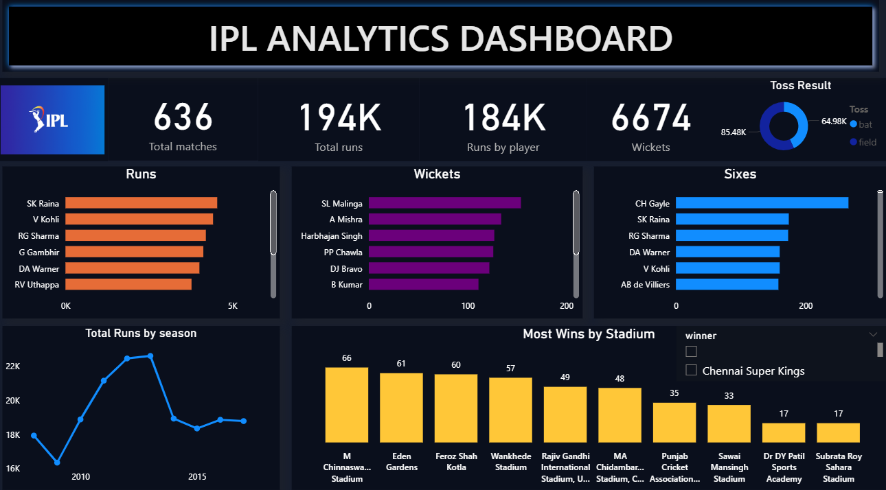
Dashboard Overview

Slide 6
Key Insights
Virat Kohli and David warner are the most reliable players
Suresh Raina is the top run scorer.
Lasith Malinga dominates as the leading wicket-taker.
Chris Gayle leads in sixes – power-hitter king.
Toss winning does not always guarantee victory.
Chepauk & Wankhede Stadiums are lucky venues.

Slide 7
Teamwise strength and weakness
🟡 Chennai Super Kings (CSK)
Strength: Strong batting lineup (Raina, Dhoni consistently in top charts).
Weakness: Heavy reliance on spinners; struggles in away matches.
Improvement: Strengthen pace bowling attack for balance.
🔵 Mumbai Indians (MI)
Strength: Balanced team with both batting and bowling dominance.
Weakness: Concede more extras in certain seasons.
Improvement: Focus on disciplined bowling to reduce extras.
🔴 Royal Challengers Bangalore (RCB)
Strength: Star batsmen (Kohli, AB de Villiers) lead in run-scoring.
Weakness: Bowling department collapses, giving away high scores.
Improvement: Improve death overs bowling strategies.

Slide 8
Conclusion
Power BI dashboard highlights top performers and trends.
Useful for cricket analysts and IPL franchises.
Scope: Extend analysis with player form, team strategies, fan engagement.

Slide 9
Thank You
Presented by: Ayush Verma
Internship Project

